Slide 1
Youth Unemployment
Ravan Iskandarov
Haji Akhundzada
Arzuman Hasanov

Slide 2
Abstract
In this presentation, our primary focus is on Youth Unemployment in Azerbaijan. We employ R programming for a detailed analysis of this critical issue, examining the various facets and repercussions of youth unemployment within the country. We're taking ideas from successful youth employment projects in other countries to create a custom 5-year plan that fits the situation in Azerbaijan. Our main goal is to use data and smart planning to reduce youth unemployment and improve the lives of young people in Azerbaijan.
2

Slide 3
Motivation
Unleash the Potential: Empower Youth, Empower Azerbaijan.
Qualifications Deserve Opportunities: Let's Bridge the Gap.
From Statistics to Success Stories: Building a Brighter Tomorrow.
Today's Youth, Tomorrow's Leaders: Invest in the Future.
Together, We Illuminate the Way Forward.
3

Slide 4
Datasets
We have used following datasets:
Azerbaijan Youth Unemployment Rate 1991-2022 (from macrotrends, ASIS)
32 entries,
Columns: annual_change, youth_unemployment_rate, year
Azerbaijan GDP Growth Rate 1991-2022 (from macrotrends)
32 entries,
Columns: annual_change, gdp_growth_rate, year
Higher education institutions (from ASIS)
28 entries,
Columns: Number of students, admitted, completed
4

Slide 5
Data Preparation and Cleaning
Our datasets were obtained from Azerbaijani websites, so the first task was to translate them into English. After that we have transposed the entire file, and we have deleted some rows and columns that we didn't need. We have deleted the following:
Number of people receiving assistance due to unemployment (individuals), men, women.
Number of faculty members in higher education institutions.
Number of individuals who have received a master's degree.
Number of individuals who have received a bachelor's degree.
Number of individuals sent for vocational training.
Number of job openings for the demand for labor force.
5

Slide 6
Methods
Mean: Find the average youth unemployment rate (14.53%).
AES: Specify data-to-plot aesthetics mapping.
TRANSPOSE: Change the orientation of a cell range (horizontal to vertical or vice versa).
geom_line: Connect data points with lines to show trends.
Title: Add a plot title.
Caption: Show the dataset source.
6

Slide 7
Research Questions
What is the economic impact of youth unemployment?
What is the impact of higher education on unemployment?
7

Slide 8
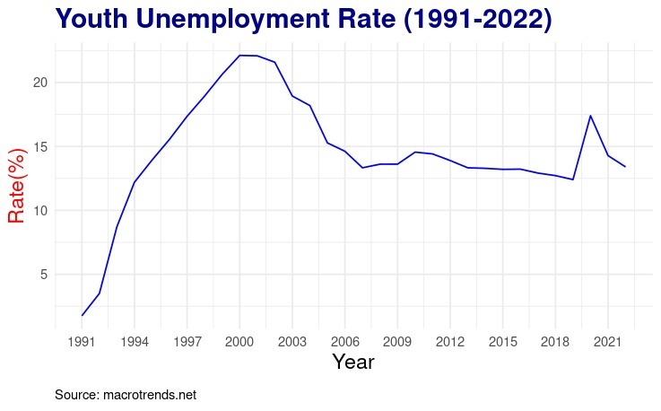
Findings
8

Slide 9
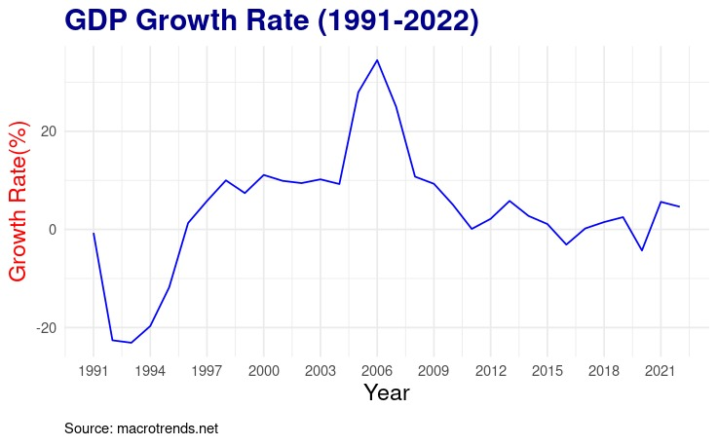
Findings
9

Slide 10
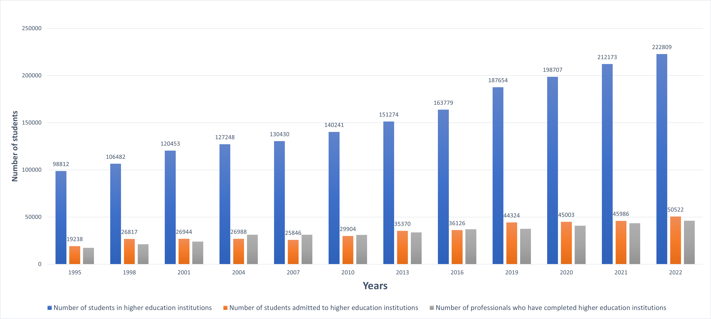
Findings
Educational Rate
10

Slide 11
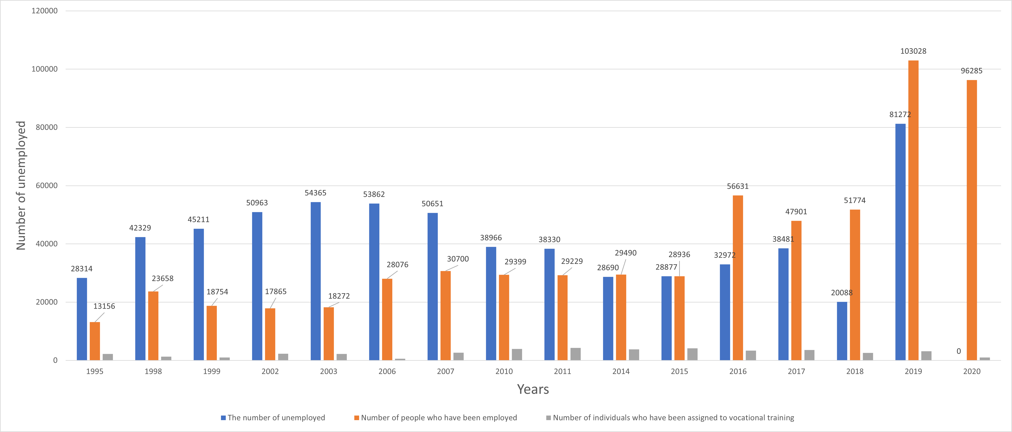
Findings
State Employment Agency's statistics
11

Slide 12
Limitations
Young unemployed individuals not registering as unemployed in the system.
It is difficult to find datasets for the field of Youth Unemployment in Azerbaijan due to their limited availability.
12

Slide 13
Conclusions
01
02
Economical influence
The rate of youth unemployment has an inverse relationship with GDP growth.
Educational impact
Despite the increase in the number of students admitted to universities, the level of unemployment also increases.
13

Slide 14
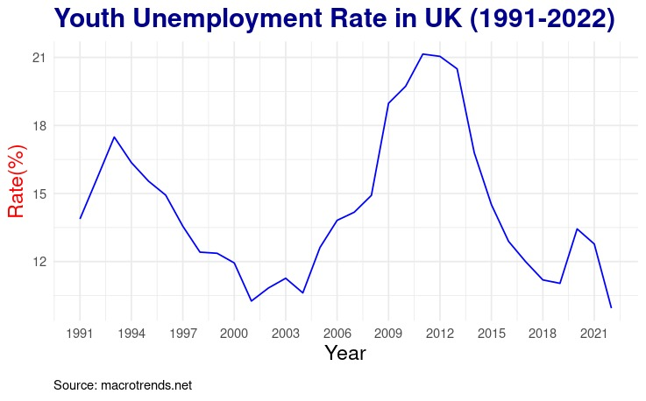
14

Slide 15
5-Year Plan: Empowering Azerbaijani Youth for a Prosperous Future
Year 1 - Registration and Promotion
In our first year, we'll initiate the program, emphasizing creating awareness and excitement. Our official launch will involve robust promotional campaigns and educational outreach to inform Azerbaijani youth about the benefits of registering as unemployed. By year's end, we envision a landscape where the youth are not just aware but eager participants, empowered by the knowledge that they're taking the first step toward a more prosperous future. The program's launch, along with our promotional and educational efforts, opens doors to a journey brimming with promise and potential for each young individual.
15
Year 2 - Work Experience, and Employer Cooperation
Expanding Work Experience: We'll broaden the work experience placements for registered youth by collaborating with companies. This creates a diverse range of valuable opportunities that boost their employability.
Education and Training Support: Our commitment to registered youth's growth continues with education and vocational training support. We'll enhance these efforts by working closely with educational institutions and industry partners to align training programs with job market needs, ensuring participants have the right skills for meaningful employment.

Slide 16
Year 3 - Expanding Registration, Tailored Support, and Rural Outreach
In the third year, we'll take a more personalized approach. We'll offer tailored assistance and mentorship to registered job seekers who are facing specific challenges. At the same time, we'll extend our reach to rural areas, ensuring that young job seekers in less urbanized regions have access to registration and support services.
Commencing this year, we are well-equipped with the necessary resources to substitute practical classes in universities with this program. Our objective is to assist young individuals in acquiring more valuable and practical experience.
Year 4 - Facilitating Hiring After Training
Year four is all about getting our registered individuals ready for the workforce. We'll put more focus on expanding apprenticeships and skill development programs. Our goal is to prepare them thoroughly for successful employment through structured training. We'll also establish pathways for these individuals to smoothly transition into the workforce after their training, connecting them with potential employers, facilitating job matching, and offering placement assistance.
16

Slide 17
Year 5 - Sustainability and Legacy
As we reach our fifth year, our focus will shift to sustainability. We'll work on strategies to ensure that the registration efforts continue beyond the initial 5-year period. We want to keep registration rates high and ensure that young people can still access support. Additionally, we'll conduct a comprehensive evaluation to measure the program's overall impact over the years. This will help us understand our achievements and learn important lessons for the future.
17

Slide 18
References
Statistics of the State Employment Agency.
Statistics of the State Employment Agency | ASIS
Azerbaijan Labor Force 1991-2023
Azerbaijan Labor Force | ASIS
Azerbaijan Youth Unemployment Rate 1991-2023
Azerbaijan Youth Unemployment Rate 1991-2023 | MacroTrends
Higher education institutions
Ali təhsil müəssisələri | ASIS
18

Slide 19
Thanks

